Slide 1

Clustering Amsterdam Neighborhoods Buurt or Wijk
Capstone Project - The Battle of Neighborhoods
Yi Li, liyi201809@gmail.com

Slide 2
Introduction
In Amsterdam, we can basically classify all neighborhoods by two regional types:
Buurt: a typical neighborhood or a localized community within a city
Wijk: a more residential area with a lot of old and/or historical family houses.
In this project, I would like to investigate
Whether these two types of region have a similar distribution of venues ?
Backwardly, can we identify the region type of a neighborhood by clustering them based on their venues?

Slide 3
Data Source
Statistics Netherlands CBS, a Dutch governmental institution
districts and neighborhoods of Amsterdam in 2016
consist of 583 columns(features) and 4019 rows(neighborhoods)

Slide 4
Methodology
Data preparation: Neighborhood, Region Type, Population, Latitude & Longitude
Merge with Venue features: Foursquare API
K-means Clustering: k = 2
Evaluation: accuracy scores and F-1 score

Slide 5
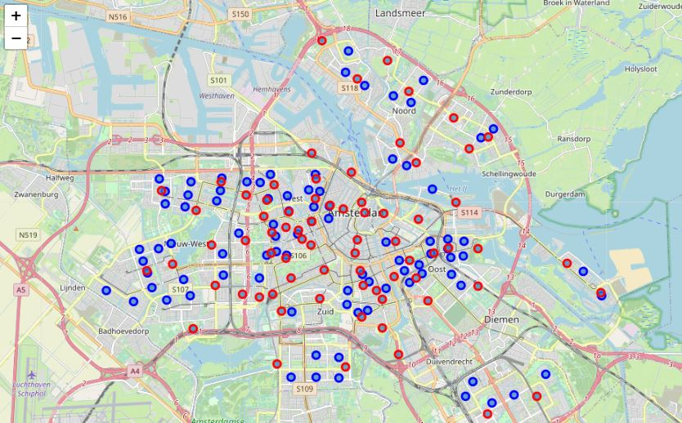
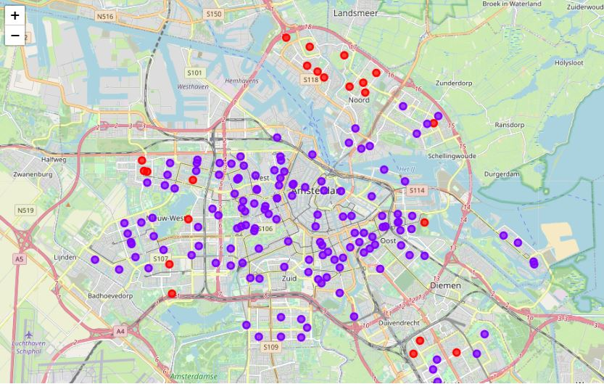
Results
Geographical distribution: Buurt/Wijk vs. Clusters on Venues

Slide 6
Result
Evaluation methods compare clustering labels (1/0), and the ground truth label converted from region_type feature, Buurt/Wijk
Accuracy: 0.5342
F-1 Score: 0.612

Slide 7
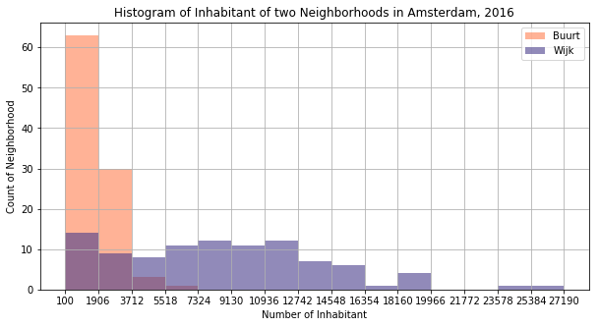
Discussion
From the geographical results
Buurt and Wijk are pretty mixed together with each other
clusters derived based on venue information are clearly separated.
From the evaluation results
that the clustering labels are not well match the ground-truth labels
Recommendation
Instead of venue information, some other feature can be more indicative for classify Buurt/Wijk. For example: inhabitant

Slide 8
Conclusion
Buurt and Wijk are geographically mixed, the distributions of their venue categories are also quite similar. It is hard to know/cluster the region types of a neighborhood based on its venue information
Some other features might be more indicative to check the region types (Buurt or Wijk). Thus, building some inferential statistical models can help to improve; however, this is out of the scope of this projects.

Slide 9
Thank you!

